Slide 1



APEX INSTITUTE OF TECHNOLOGY
DEPARTMENT OF COMPUTER SCIENCE & ENGINEERING
Database Management System (22CSH-243)
Faculty: Ms. Shaveta Jain (13464)
Lecture – 2.2
Functional Dependencies
DISCOVER . LEARN . EMPOWER

Slide 2
DBMS: Course Objectives
COURSE OBJECTIVES
The Course aims to:
Understand database system concepts and design databases for different applications and to acquire the knowledge on DBMS and RDBMS.
Implement and understand different types of DDL, DML and DCL statements.
Understand transaction concepts related to databases and recovery/backup techniques required for the proper storage of data.

Slide 3
COURSE OUTCOMES
On completion of this course, the students shall be able to:-
CO3 | Apply relational algebra and relational calculus to query the database of organization

Slide 4
Lecture Outline
Functional Dependencies
Fully Functional Dependence (FFD)
Partial Dependency
Transitive Dependency
Join Dependency
Chapter 10-<number>

Slide 5
Functional Dependencies (1)
Functional dependencies (FDs) are used to specify formal measures of the "goodness" of relational designs
FDs and keys are used to define normal forms for relations
FDs are constraints that are derived from the meaning and interrelationships of the data attributes
A set of attributes X functionally determines a set of attributes Y if the value of X determines a unique value for Y
Chapter 10-<number>

Slide 6
Functional Dependencies (2)
X -> Y holds if whenever two tuples have the same value for X, they must have the same value for Y
For any two tuples t1 and t2 in any relation instance r(R): If t1[X]=t2[X], then t1[Y]=t2[Y]
X -> Y in R specifies a constraint on all relation instances r(R)
Written as X -> Y; can be displayed graphically on a relation schema as in Figures. ( denoted by the arrow: ).
FDs are derived from the real-world constraints on the attributes
Chapter 10-<number>

Slide 7
Examples of FD constraints (1)
Social security number determines employee name
SSN -> ENAME
Project number determines project name and location
PNUMBER -> {PNAME, PLOCATION}
employee ssn and project number determines the hours per week that the employee works on the project
{SSN, PNUMBER} -> HOURS
Chapter 10-<number>

Slide 8
Examples of FD constraints (2)
An FD is a property of the attributes in the schema R
The constraint must hold on every relation instance r(R)
If K is a key of R, then K functionally determines all attributes in R (since we never have two distinct tuples with t1[K]=t2[K])
Chapter 10-<number>

Slide 9
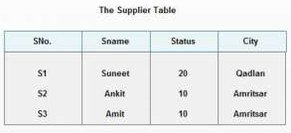
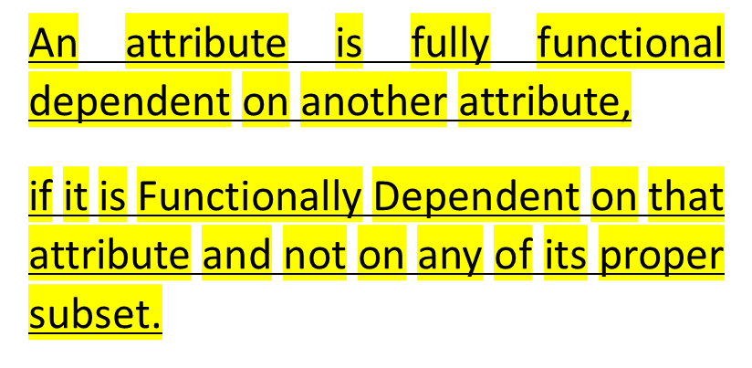
Fully Functional Dependence (FFD)
Fully Functional Dependence (FFD) is defined, as To be fully dependent,
  IF non-candidate key attributes must depend on the primary key.
  Primary Key is used to uniquely identify a database record.

Slide 10
Partial Dependency
If any proper subsets of the key determine any of the non-key attributes then there exist a partial dependency.
Example: Given a relation R(A,B,C,D,E) , Functional Dependency : AB→CDE , Primary_key(or simply 'key') is AB.
Then A→C : is a Partial Dependency
A→D : is a Partial Dependency
A→E : is a Partial Dependency
B→C : is a Partial Dependency
B→D : is a Partial Dependency
B→E : is a Partial Dependency

Slide 11
Transitive Dependency
The transitivity rule is perhaps the most important one. It states that if X functionally determines Y and Y functionally determine Z then X functionally determines Z.
    X→ Y
    Y→ Z
    X→ Z

Slide 12
Multi-Value Dependency
A Multi-Value Dependency (MVD) occurs when two or more independent multi valued facts about the same attribute occur within the same table.
Multivalued dependencies occur when the presence of one or more rows in a table implies the presence of one or more other rows in that same table.
Examples: For example, imagine a car company that manufactures many models of car, but always makes both red and blue colors of each model.
If you have a table that contains the model name, color and year of each car the company manufactures, there is a multivalued dependency in that table.
If there is a row for a certain model name and year in blue, there must also be a similar row corresponding to the red version of that same car.

Slide 13
Join Dependency
A Join Dependency exists if a relation R is equal to the join of the projections X Z.
A join dependency is a constraint on the set of legal relations over a database scheme.
A table T is subject to a join dependency if T can always be recreated by joining multiple tables each having a subset of the attributes of T.
If one of the tables in the join has all the attributes of the table T, the join dependency is called trivial.

Slide 14
Multivalued Dependencies
Suppose we record names of children, and phone numbers for instructors:
  inst_child(ID, child_name)
  inst_phone(ID, phone_number)
If we were to combine these schemas to get
  inst_info(ID, child_name, phone_number)
  Example data:
  (99999, David, 512-555-1234)
  (99999, David, 512-555-4321)
  (99999, William, 512-555-1234)
  (99999, William, 512-555-4321)
This relation is in BCNF
  Why?

Slide 15
Multivalued Dependencies (MVDs)
Let R be a relation schema and let α ⊆ R and β ⊆ R. The multivalued dependency
α →→ β
holds on R if in any legal relation r(R), for all pairs for tuples t₁ and t₂ in r such that t₁[α] = t₂ [α], there exist tuples t₃ and t₄ in r such that:
t₁[α] = t₂ [α] = t₃ [α] = t₄ [α]
t₃[β] = t₁ [β]
t₃[R – β] = t₂[R – β]
t₄ [β] = t₂[β]
t₄[R – β] = t₁[R – β]

Slide 16

MVD (Cont.)
Tabular representation of α →→ β

Slide 17
Example
Let R be a relation schema with a set of attributes that are partitioned into 3 nonempty subsets.
Y, Z, W
We say that Y →→ Z (Y multidetermines Z )
if and only if for all possible relations r (R )
< y₁, z₁, w₁ > ∈ r and < y₁, z₂, w₂ > ∈ r
then
< y₁, z₁, w₂ > ∈ r and < y₁, z₂, w₁ > ∈ r
Note that since the behavior of Z and W are identical it follows that
Y →→ Z if Y →→ W

Slide 18
Example (Cont.)
In our example:
ID →→ child_name
ID →→ phone_number
The above formal definition is supposed to formalize the notion that given a particular value of Y (ID) it has associated with it a set of values of Z (child_name) and a set of values of W (phone_number), and these two sets are in some sense independent of each other.
Note:
  If Y → Z then Y →→ Z
  Indeed we have (in above notation) Z₁ = Z₂
  The claim follows.

Slide 19
Use of Multivalued Dependencies
We use multivalued dependencies in two ways:
  1. To test relations to determine whether they are legal under a given set of functional and multivalued dependencies
  2. To specify constraints on the set of legal relations. We shall thus concern ourselves only with relations that satisfy a given set of functional and multivalued dependencies.
If a relation r fails to satisfy a given multivalued dependency, we can construct a relations r′ that does satisfy the multivalued dependency by adding tuples to r.

Slide 20
Theory of MVDs
From the definition of multivalued dependency, we can derive the following rule:
  If α → β, then α →→ β
That is, every functional dependency is also a multivalued dependency
The closure D⁺ of D is the set of all functional and multivalued dependencies logically implied by D.
  We can compute D⁺ from D, using the formal definitions of functional dependencies and multivalued dependencies.
  We can manage with such reasoning for very simple multivalued dependencies, which seem to be most common in practice
  For complex dependencies, it is better to reason about sets of dependencies using a system of inference rules (see Appendix C).

Slide 21
Restriction of Multivalued Dependencies
The restriction of D to R_{i} is the set D_{i} consisting of
  All functional dependencies in D⁺ that include only attributes of R_{i}
  All multivalued dependencies of the form
    α →→ (β ∩ R_{i})
  where α ⊆ R_{i} and α →→ β is in D⁺

Slide 22
Further Normal Forms
Join dependencies generalize multivalued dependencies
  lead to project-join normal form (PJNF) (also called fifth normal form)
A class of even more general constraints, leads to a normal form called domain-key normal form.
Problem with these generalized constraints: are hard to reason with, and no set of sound and complete set of inference rules exists.
Hence rarely used

Slide 23
References
RamezElmasri and Shamkant B. Navathe, “Fundamentals of Database System”, The Benjamin / Cummings Publishing Co.
Korth and Silberschatz Abraham, “Database System Concepts”, McGraw Hall.
C.J.Date, “An Introduction to Database Systems”, Addison Wesley.
Thomas M. Connolly, Carolyn & E. Begg, “Database Systems: A Practical Approach to Design, Implementation and Management”, 5/E, University of Paisley, Addison-Wesley.

Slide 24

THANK YOU
For queries
Email: shaveta.e13464@cumail.in

